Slide 1

Academic Session 2025-26
Even Semester Jan-May 2025
UNIVERSITY INSTITUTE OF ENGINEERING
AIT-CSE (AIML)
CS221: B.E. CSE (AIML)
5th Semester
ADVANCED MACHINE LEARNING & MATHEMATICAL MODELLING
(23CSH-382)
Unit No. 1 Chapter No. 1 Lecture No. 6, 7 & 8
Topic: Maxima and Minima for Several Variables and Convexity of Errors Function
Mr. Siddharth Kumar (E12853) Assistant Professor

Slide 2
COURSE OBJECTIVES
1
The course aims to:
To develop a strong mathematical foundation for regression-based predictive modelling using calculus, matrix algebra, and probability theory.
To provide an in-depth understanding of supervised classification algorithms including KNN, Support Vector Machines, and ensemble-based boosting approaches.
To equip learners to implement clustering and probabilistic reasoning models such as Spectral Clustering, Markov Chains, Bayesian Networks, and HMMs.
To cultivate the ability to design neural networks, implement multilayer perceptron, and optimize training using backpropagation and regularization strategies.
To expose students to advanced deep learning frameworks, feature abstraction hierarchies, and performance enhancement through hyper-parameter tuning & dropout.

Slide 3

COURSE OUTCOMES
2
On completion of this course, the students shall be able to:
CO1 | Recall the foundational concepts, terminology, and mathematical principles underlying regression, classification and clustering approaches.
CO2 | Illustrate the working mechanisms, characteristics, and theoretical concept of regression, clustering and classification techniques in machine learning.
CO3 | Apply appropriate regression, clustering and classification algorithms to solve real-world machine learning tasks while addressing performance constraints.
CO4 | Analyze and evaluate machine learning models using performance parameters to identify the best-suited techniques for specific applications regression, clustering and classification algorithms.
CO5 | Design and implement optimized machine learning solutions by integrating regression, clustering and classification models to solve complex predictive and decision-making problems.

Slide 4
Unit-I Syllabus
3
Unit-1 | Regression | Contact Hours: 15
Regression | Linear and Polynomial Regression, Maxima and Minima of Function of One Variable, Rank, Eigen Values and Eigen Vectors, Positive & Negative Definite/Semi-definite Matrices
Error Estimation | Maxima and Minima of Function of Several Variables, Convexity of Errors Function, Building Simple Linear Regression Model by Solving Normal Equations, Gradient Descent, Stochastic & Mini-batch Gradient Descent Algorithm
Probability Theory | Discrete Probability Distributions, Continuous Probability Distributions, Normal Distribution and t-Distributions, RSE, R²

Slide 5
SUGGESTIVE READINGS
4
Text Books / Reference Books:
TEXT BOOKS
T1: Massaron, L., & Boschetti, A. (2016). Regression analysis with Python. Packt Publishing Ltd.
T2: Jajuga, K., Sokolowski, A., & Bock, H. H. (Eds.). (2012). Classification, clustering, and data analysis: recent advances and applications.
T3: Bishop, C. M., & Bishop, H. (2023). Deep learning: Foundations and concepts. Springer Nature.
REFERENCE BOOKS
R1: Matloff, N. (2017). Statistical regression and classification: from linear models to machine learning. Chapman and Hall/CRC.
R2: Jajuga, K., Sokolowski, A., & Bock, H. H. (Eds.). (2012). Classification, clustering, and data analysis: recent advances and applications.
R3: Vishnoi, V. K., Chauhan, N. R., & Kumar, K. (2024). An introduction to deep learning. Xoffencer publication.

Slide 6
Table of Contents
5
Maxima and Minima of Function of Several Variables
Convexity of Errors Function
Building Simple Linear Regression Model by Solving Normal Equations

Slide 7
Maxima and Minima of Function of Several Variables
6
Maxima and Minima refer to the highest and lowest points of a function's graph, respectively, within a given domain.
These points are also called turning points since the slope of the function (derivative) becomes zero at these positions.
1. Function of Several Variables
Let 𝑓: 𝑅^{𝑛}→𝑅, 𝑓=𝑓(𝑥₁,𝑥₂,…,𝑥_{𝑛})
We are interested in points where 𝑓 attains:
Local maximum
Local minimum
Or saddle points (neither max nor min)

Slide 8
Maxima and Minima of Function of Several Variables
7
2. Local Maxima and Minima (Definitions)
Let 𝑥₀ ∈ 𝑅^{𝑛} be a point.
Local minimum at 𝑥₀:
There exists 𝛿>0such that𝑓(𝑥)≥𝑓(𝑥₀) for all ∥𝑥−𝑥0∥<𝛿
Local maximum at 𝑥₀​:
There exists 𝛿>0such that𝑓(𝑥)≤𝑓(𝑥0)for all ∥𝑥−𝑥0∥<𝛿f
Saddle point: 𝑥₀ is a critical point where 𝑓 is neither a local min nor a local max (in some directions it increases, in others it decreases).

Slide 9
Convexity of Errors Function
8
In the field of machine learning, the main objective is to find the most “fit” model trained over a particular task or a bunch of tasks.
To do this, one needs to optimize the loss/cost function, and this will assist in minimizing error.
One needs to know the nature of concave and convex functions since they are the ones that assist in optimizing problems effectively.
These convex and concave functions form the foundation of many machine learning algorithms and influence the minimization of loss for training stability.
In this chapter, we’ll learn what concave and convex functions are, their differences, and how they impact the optimization strategies in machine learning.

Slide 10
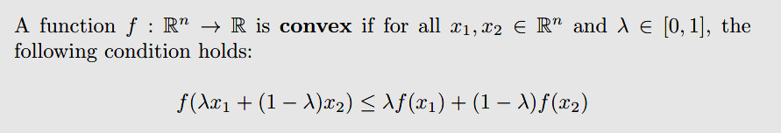
Convexity of Errors Function
9
What is a Convex Function?
In mathematical terms, a real-valued function is convex if the line segment between any two points on the graph of the function lies above the two points.
In simple terms, the convex function graph is shaped like a “cup “ or “U”.
A function is said to be convex if and only if the region above its graph is a convex set.

Slide 11
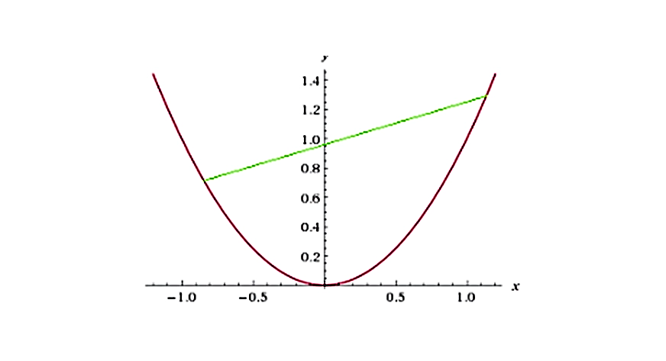
Convexity of Errors Function
10
In mathematical terms, a real-valued function is convex if the line segment between any two points on the graph of the function lies above the two points.
In simple terms, the convex function graph is shaped like a “cup “ or “U”.
A function is said to be convex if and only if the region above its graph is a convex set.
Figure-1: Convex Function Curve

Slide 12
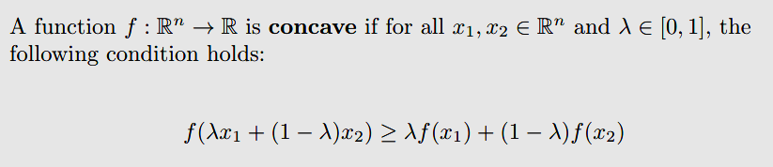
Convexity of Errors Function
11
What is a Concave Function?
Any function that is not a convex function is said to be a concave function. Mathematically, a concave function curves downwards or has multiple peaks and valleys.
This means that if any two points are present in the subset that contains the whole segment joining them, then it’s a convex function, otherwise, it’s a concave function.

Slide 13
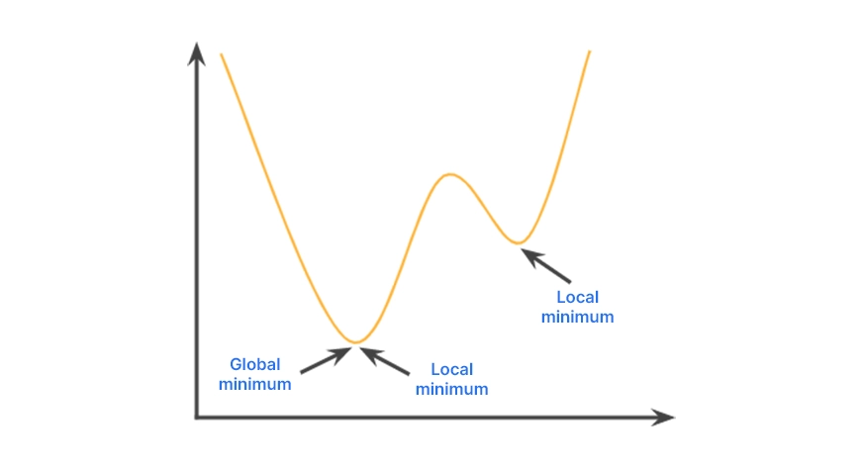
Convexity of Errors Function
12
This inequality violates the convexity condition. Here is the characteristic curve for a concave function:
Loss/Cost functions: Loss function is the difference between the actual value and the predicted value of the machine learning algorithm from a single record.
Figure-2: Characteristic Curve
While the cost function aggregated the difference for the entire dataset.
Loss and cost functions play an important role in guiding the optimization of a machine learning algorithm.

Slide 14
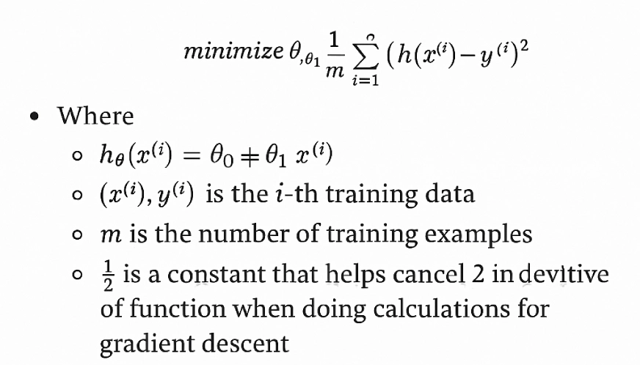
Convexity of Errors Function
13
They show quantitatively how well the model is performing, which serves as a measure for optimization techniques like gradient descent, and how much the model parameters need to be adjusted.
By minimizing these values, the model gradually increases its accuracy by reducing the difference between predicted and actual values.

Slide 15
Regression Model by Solving Normal Equations
14
Building Simple Linear Regression Model by Solving Normal Equations
Linear regression is a popular method for understanding how different factors (independent variables) affect an outcome (dependent variable.
At its core, linear regression aims to find the best-fitting line that minimizes the error between observed data points and predicted values.
One efficient method to achieve this is through the use of the normal equation.
In this chapter, we will understand in-depth into the details of the normal equation, its mathematical derivation, implementation, and comparison with other optimization methods like gradient descent.

Slide 16
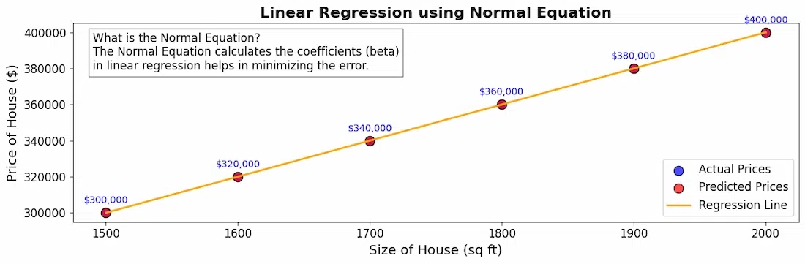
Regression Model by Solving Normal Equations
15
The normal equation is a mathematical formula that provides a straightforward way to calculate the coefficients (β) in linear regression.
Figure-3: Linear Regression using Normal Equation

Slide 17

Regression Model by Solving Normal Equations
16
Instead of using trial-and-error or iterative methods, the normal equation allows us to find the best coefficients directly. The formula for the normal equation is:
In the above equation,
θ: hypothesis parameters that define it the best.
X: Input feature value of each instance.
Y: Output value of each instance.
The Normal Equation leverages the power of matrix algebra to efficiently handle multiple independent variables in linear regression.

Slide 18
Regression Model by Solving Normal Equations
17
By organizing the data into matrices, the equation helps in linear transformations and calculations that simplify the process of finding the best-fitting coefficients.
One of the significant advantages of the Normal Equation is its computational efficiency, especially for small to medium-sized datasets.
Unlike iterative methods such as gradient descent, which require multiple passes over the data to converge on the optimal coefficients, the Normal Equation calculates all coefficients in one shot.
This results in faster computations and a straightforward implementation when the dataset size is manageable.

Slide 19
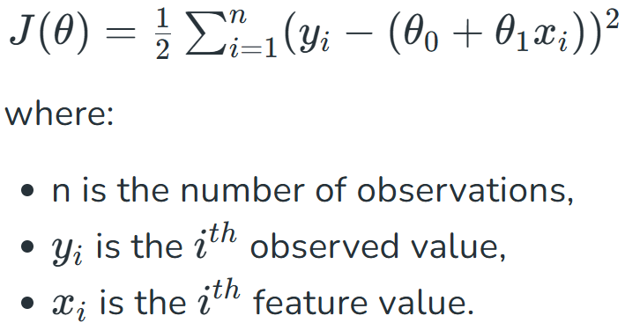
Regression Model by Solving Normal Equations
18
However, it is essential to note that as the number of features or data points increases significantly, the computation of the inverse of the matrix can become computationally expensive, leading to potential issues with numerical stability.
Mathematical Derivation: Behind the Equation
To derive the Normal Equation, we start with the least squares minimization problem, aiming to minimize the sum of squared residuals:

Slide 20
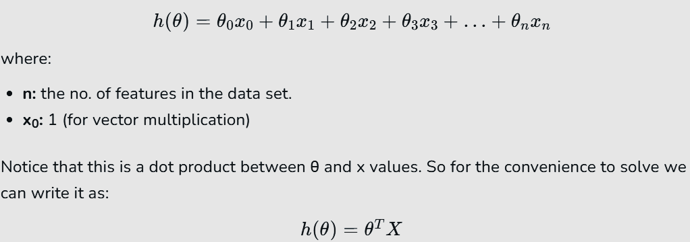
Regression Model by Solving Normal Equations
19
Explanation of the Hypothesis Function
Given the hypothesis function,

Slide 21
Regression Model by Solving Normal Equations
20
The Normal Equation vs Gradient Descent
These are the two primary methods for estimating the coefficients (parameters) in Linear Regression Model.
Each method has its unique advantages and considerations, making them suitable for different scenarios.
Let's see a detailed comparison between these two approaches. The normal equation provides an analytical solution, computing the optimal parameters in a single step.
Gradient descent uses an iterative approach, updating the parameters until convergence.

Slide 22
Regression Model by Solving Normal Equations
21
The Normal Equation provides a closed-form solution to linear regression, allowing for the computation of optimal coefficients in one step.
This method is efficient for small to medium-sized datasets because it relies on straightforward matrix operations.
However, its dependence on matrix inversion can become computationally expensive with large datasets.
Additionally, the Normal Equation does not require hyperparameter tuning, making its implementation simpler.

Slide 23
Regression Model by Solving Normal Equations
22
In contrast, Gradient Descent is an iterative optimization algorithm that adjusts the coefficients incrementally based on the gradient of the cost function.
This method is particularly effective for large datasets, as it can process data points one at a time or in mini-batches, thereby reducing memory requirements.
While Gradient Descent may take longer to converge compared to the Normal Equation, its performance can be significantly influenced by the choice of learning rate, which necessitates some degree of hyperparameter tuning.
Furthermore, there are several variants of Gradient Descent, including stochastic and mini-batch methods, that can improve convergence speed and model generalization.

Slide 24
Applications of the Topic
23
Here are applications:
Optimization of machine learning model parameters.
Hyperparameter tuning to maximize accuracy or minimize error.
Profit maximization and cost minimization in economics.
Guarantees global minimum in optimization problems.
Ensures stable convergence of gradient descent algorithms.
Helps select ML loss functions with reliable behavior.
Reduces risk of local minima in training.
Fast model fitting for small/medium datasets.
Explainable predictive modeling in business and healthcare.

Slide 25
Summary of the Lecture
24
The lecture focused on fundamental mathematical concepts used in machine learning and data science for optimization and model building. It began with the study of maxima and minima in functions of several variables, which is essential for solving optimization problems that arise in model training, parameter tuning, and engineering.
The concept of convexity of error functions was then introduced, highlighting its importance in ensuring reliable and stable optimization. Convex error functions guarantee a single global minimum, enabling methods like gradient descent.
Finally, the lecture discussed how to construct a simple linear regression model using normal equations. This method provides a direct formula to compute model parameters without iterative techniques, making it effective for small datasets.

Slide 26
Next Lecture
25
In next lecture, we are going to cover:
Gradient Descent
Stochastic Gradient Descent Algorithms
Mini-Batch Gradient Descent Algorithms

Slide 27
Quiz/ FAQ’s
26
Define maxima and minima for a function of several variables.
Explain the condition for local maxima/minima using partial derivatives.
What is the Hessian matrix and how is it used in optimization?
What is a convex function? Give its mathematical definition.
Why is convexity important in machine learning?
Explain how convexity ensures the existence of a global minimum.
Derive the normal equations for linear regression.
State the formula for computing regression coefficients using normal equations.
Compare gradient descent and normal equation methods.

Slide 28
References/ Articles/ Videos
27
Text/ Reference Books
T1 | Massaron, L., & Boschetti, A. (2016). Regression analysis with Python. Packt Publishing Ltd.
T2 | Jajuga, K., Sokolowski, A., & Bock, H. H. (Eds.). (2012). Classification, clustering, and data analysis: recent advances and applications.
T3 | Bishop, C. M., & Bishop, H. (2023). Deep learning: Foundations and concepts. Springer Nature.
R1 | Matloff, N. (2017). Statistical regression and classification: from linear models to machine learning. Chapman and Hall/CRC.
R2 | Jajuga, K., Sokolowski, A., & Bock, H. H. (Eds.). (2012). Classification, clustering, and data analysis: recent advances and applications.
R3 | Vishnoi, V. K., Chauhan, N. R., & Kumar, K. (2024). An introduction to deep learning. Xoffencerpublication.

Slide 29
Faculty-curated videos, NPTEL, Coursera, LinkedIn, or other relevant learning resources
28
https://youtu.be/pRSqKgwOd5k
https://youtu.be/pjYgiOE7E8o
https://www.coursera.org/learn/ismdl?source=admin-share
https://www.coursera.org/learn/ai-for-real-world-intelligence-systems?source=admin-share
https://www.coursera.org/learn/ai-for-real-world-intelligence-systems?source=admin-share
https://www.coursera.org/learn/deep-learning-applications-in-vision?source=admin-share
https://www.coursera.org/learn/deep-learning-applications-in-vision?source=admin-share
https://www.coursera.org/learn/ismdl?source=admin-share

Slide 30

29
Class-Wise Feedback
Note: Scan this QR code to provide anonymous feedback.

Slide 31
30
Thank You
For queries
Email: siddharth.e12853@cumail.in

